Slide 1
RFI Issues at AO
Phil Perillat

Slide 2
Talk outline
AO Receiver list
Lband:
Radars, global navigation satellites
Light squared 1670-1675
Sband radar:
2390 ism cheaters, low level rfi at 2380, AT&T at 2370
Sband wide: 2130 notched filter for pulsar observers
Cband: 5150 uni band cheaters
Miscellaneous things.

Slide 3
AO receiver coverage
Receiver | Freq range | Receiver | Freq range
47Mhz | 1Mhz | SbandLo | 1800-3100
327 | 302-352 | SbandHi | 3000-4000
430 dome | 418-422 | Cband | 3850-6000
750 | 705-800 | CbandHi | 5900-8100
Lband | 1150-1730 | Xband | 7800-10000
Alfa-7beam | 1225-1525
Sb radar | 2330-2430

Slide 4
Lband issues
Lband Radar
Global navigation satellites
Light squared 1670-1675 and the 1665/1667 OH lines

Slide 5
Lband radars seen by AO
Radar | Info
FAA radar | Old 1330,1350 – no blanking New:1252,1258,1344,1350 (CARSR) blanks 4 degs in AO direction
Punta Borinquen radar | Old : 1270 or 1290 New:1269,1276,1327,1333 (CARSR) Blanks 4 degs in AO direction
Punta Salinas radar | Frequency agile radar Old:1232,1247,1242,1256 (ModeA) New:1228,1243,1279,1294 blanks 22 deg in AO direction
Aerostat radar balloon | 1246,1261 line of site to dish makes it extremely strong. They blank +/-21 degrees in AO direction

Slide 6
CARSR radars
The FAA and PuntaBorinqen radars were replaced by CARSR (Common Air Route Surveillance Radar) in 2013
Run by FAA but only used by DOD,DHS.
They are blanking the radars +/- 2 degrees toward AO.
We needed a memo from DoD,DHS to get the blanking.
We could use a few more degrees of blanking, to lessen intermods.
How the upgrades made things worse:
Went from 3 freq to 8 frequencies. More interference, more intermods (if radar pulses overlap in time).
Lower power, but duty cycle went .5% to 10%
Multiple ipps so there are many more periods to interfere with pulsar observing.
Positive: they blank in our direction. Old ones didn’t.
Radar | Freq | Bandwd | Duty cycle | Sector Blanking | Dist nmi
Old FAA | 1330,1350 | .2 Mhz | .5% | no | 57
CARSR FAA | 1252.4,1257.6 1344.4,1349.6 | 1 Mhz chirped | 9% | Yes (01nov14) +/-2 deg | 57
Old Punta Borinquen | 1270 or 1290 | .2 Mhz | .5% | no | 24
CARSR PuntaBor. | 1269.4,1274.6 1327.4,1332.6 | 1 Mhz Chirped | 9% | Yes (01oct13) +/- 2 deg | 24

Slide 7
Punta Salinas radar
Punta Salinas is a freq. Agile phased array radar
Apr 15 upgraded from 18 to 100 dual freq channels.
They will no longer xmit freq close to other radars on the island
MOU: when AO uses lband, they use 2 dual freq channels (called modeA).
We’ve had some trouble with this, especially during their upgrades.

Slide 8
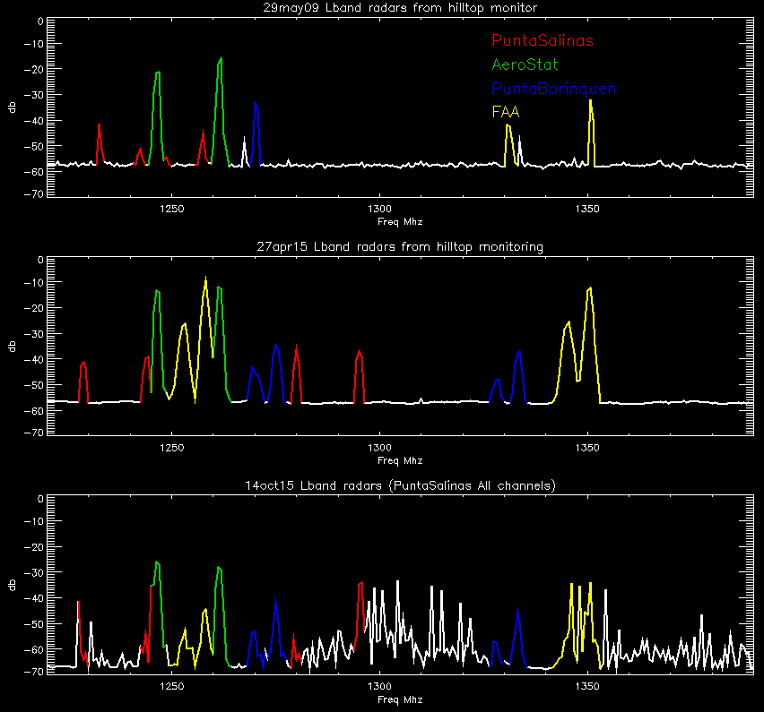
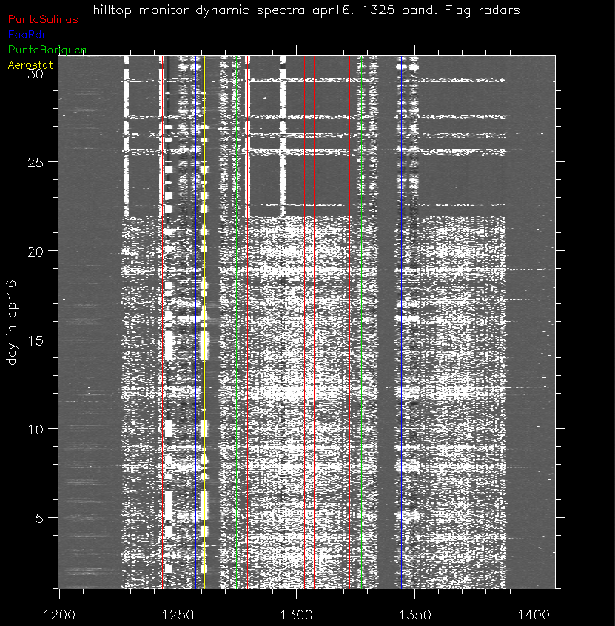
Radar from hilltop monitor
Compare radar frequency usage:
Top: 29may09 pre CARSR, pre PuntaSalinas upgrage
middle:27apr15:CARSR, new puntaSalinas (modeA)
Bottom:14oct15:CARSR, new puntaSalinas, all chan.
Example of Punta Salinas coordination.
April2016 we were painting the platform until 21apr16. During this time punta Salinas was allowed to run using all 100 channels.
If the coordination fails, then the lband experiment is wiped out.

Slide 9
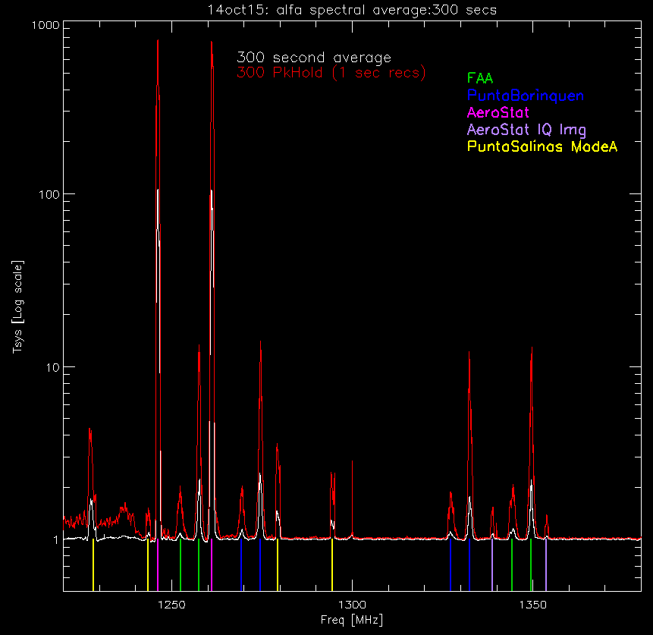
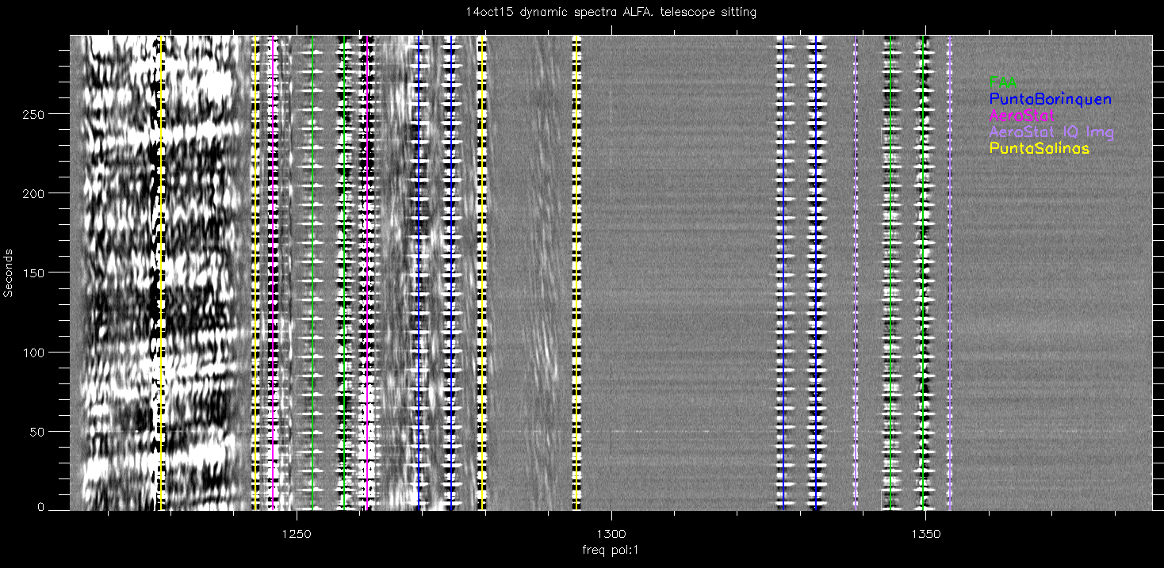
Example of rfi in ALFA receiver
300 1 sec integrations with alfa receiver
1220 to 1390 MHz band.
Telescope sitting, sky drifting.
Dynamic spectrum (flattened by median)
Image shows:
Radars, 12 sec rotation periods
IQ image of aerostat
GPS L2, glonass, probably Galileo
The plot shows a 300 second average and 300 second peak hold.
The peak value has been decreased by the radar duty cycle (10%). Instantaneously it it 10 times stronger.
You can see why the aerostat generates an IQ image…

Slide 10
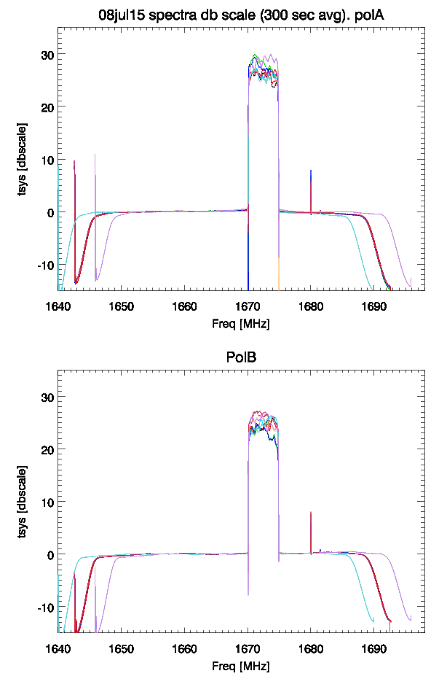
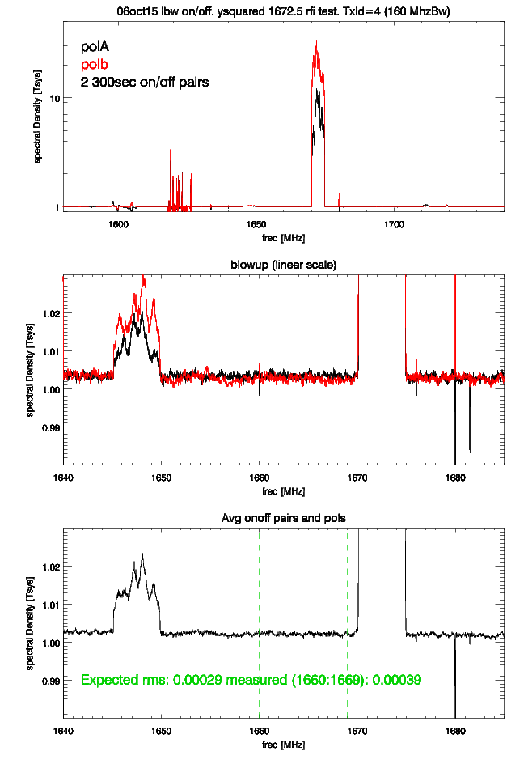
LightSquared: 1670-1675
Using 1670-1675 band (after gps fiasco)
Their transmitter met the fcc out of band spec by only .4 db (43+log(P))
5 towers. 2 are line of sight to AO.
Jul15 LS testing with towerID 2 (11.5 miles)
They hadn’t put in their PRCZ request before testing.
06oct15: LS testing with AO.
Decided they didn’t need towerID 2
TowerId 4 is line of sight, 26 miles.
14oct15 LS decided they will not use towerId 4
Other towers: 1,5,6 are .5 to 1% of tsys in 1670 to 1675 Mhz band

Slide 11
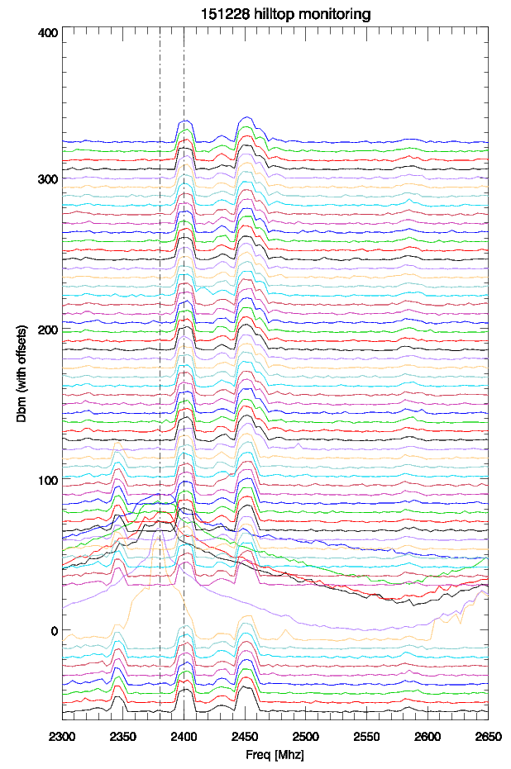
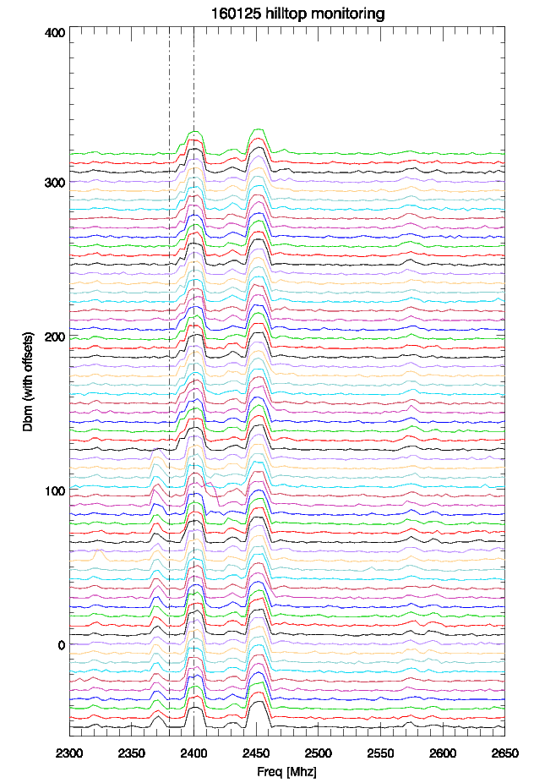
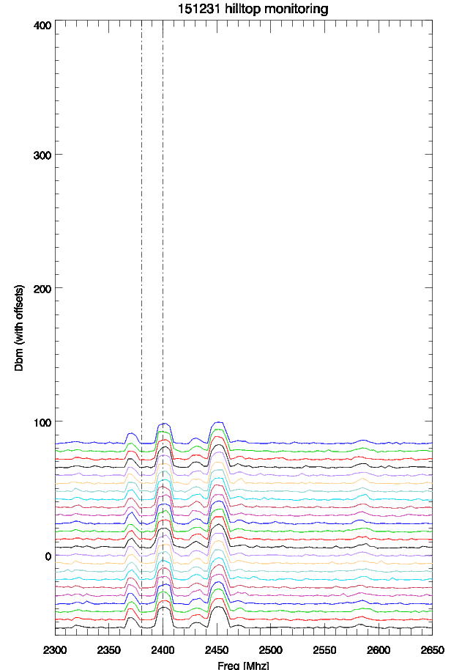
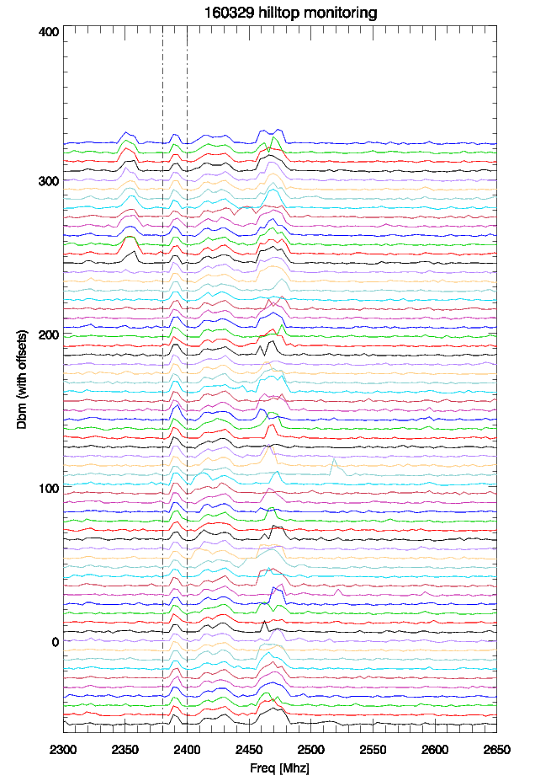
sband
1997 WCS auction #14, Coloma wireless bought blocks A-D and then sold them to AT&T.
The 2345-2350 band status:
28dec15 went off the air
31dec15 came back on at 1270-1275
This is inside our sband transmitter band
25jan16 went off the air.
they were at 1270-1275 for almost a month.
29mar16: back on the air at 2350.
BlockName | LowerFreqBlock | UpperFreqBlock
A | 2305-2310 | 2350-2355
B | 2310-2315 | 2355-2360
C | 2315-2320
D | 2345-2350

Slide 12
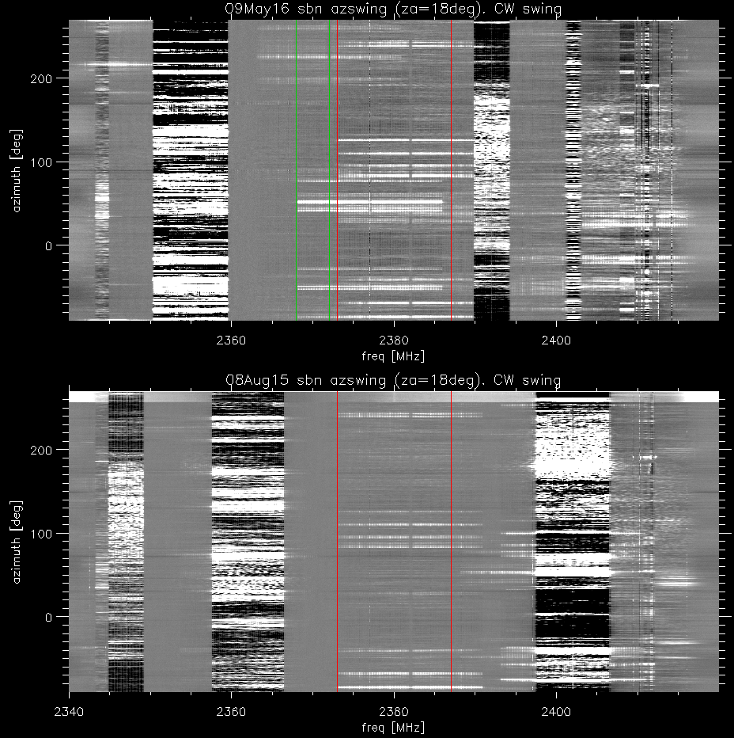
Planetary radar interference
Frequency allocations
2360-2390: mobile medical body networks, aviation flight,missile testing
The planetary radar covers 2370 to 2390 MHz
The unregulated ISM band starts at 2400 MHz
Azimuth swings 09may16 and 05aug15 showed:
Aug15: 2350-2360 band at 2358-2367
Aug15,May16: 2372-2392 interference (weak)
May16: 2367-2387
May16: 2390-2395. very strong
Aug15: 2398-2408

Slide 13
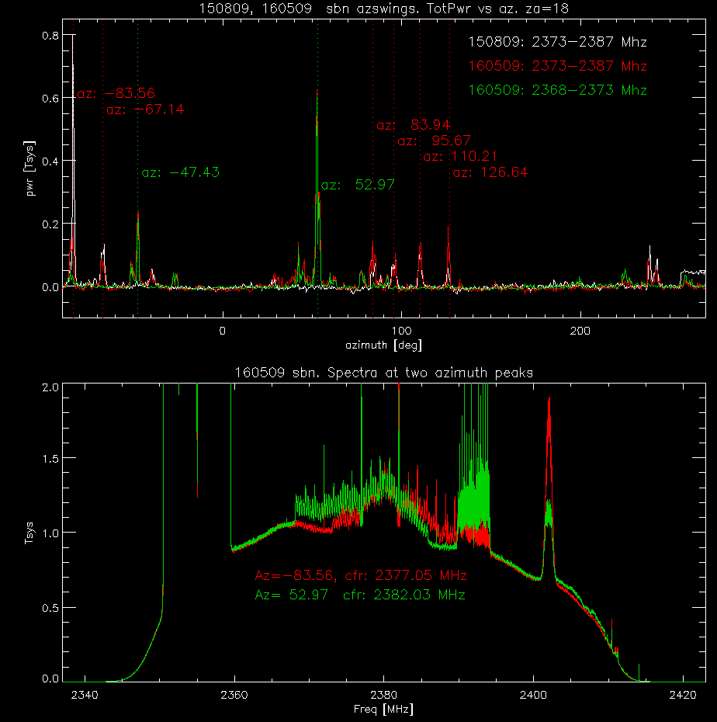
Planetary radar (continued)
Average the power within the red, green lines of the image and then plot versus azimuth angle.
The 2373-2393 pks (white/red) are stationary in azimuth aug15 and may16. Pk at -84 degrees.
They show peaks separated by 180 degrees. Direction is probably parallel or perpendicular to azimuth direction.
The 2368-2388 is new may16. peaks at az=53 deg.
Moving the LO showed that they are not intermods.
Bottom plot shows 1sec spectra at the two peaks.
Dana & I went looking for this in jan16.. No luck.
Looks like OFDM from an ISM internet provider (or user)

Slide 14
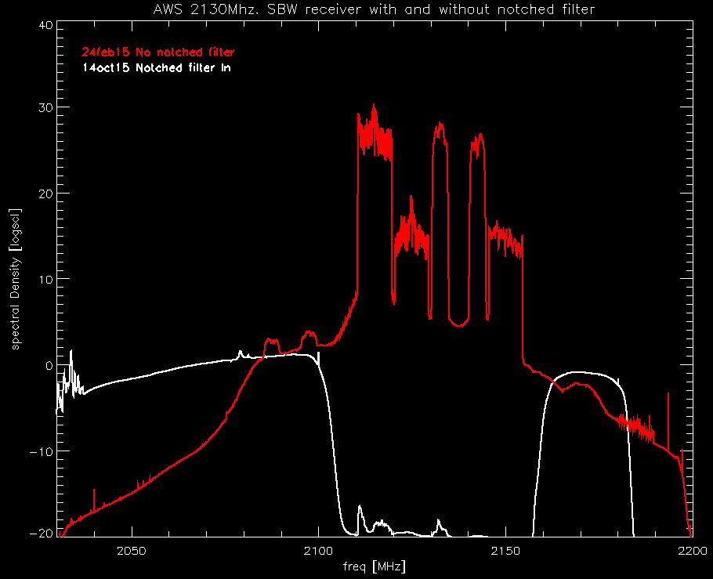
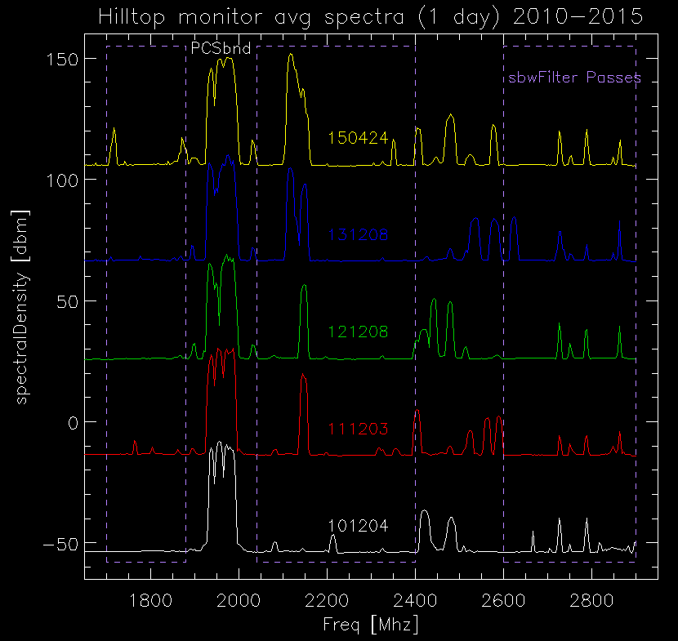
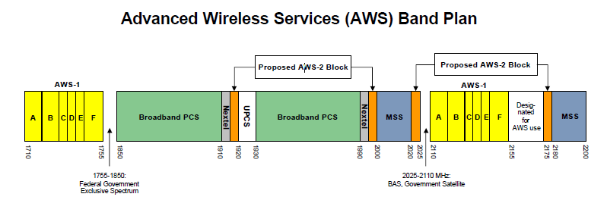
SbandWide: 2130 Notched filter
Sband wide 1700-3100 Mhz has a selectable rfi filterbank:
1770-1880
2040 – 2400
2600-3100
Hilltop monitor data shows evolution of sband rfi:
2110-2150 rfi appeared after filter bank installed.
AWS Band
AWS1 2110-2150 was causing problems with pulsar observing.
In oct15 installed a permanent notched filter.
Cuts down on intermods that were spreading outside the band.

Slide 15
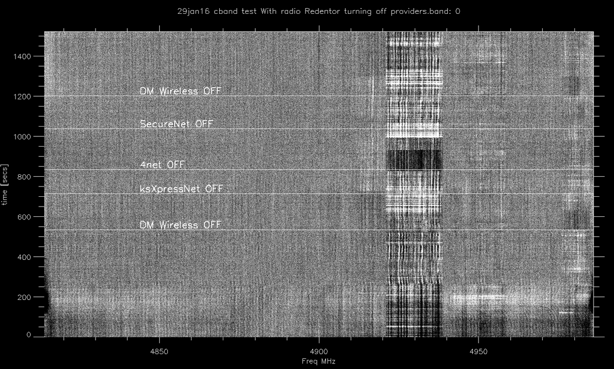
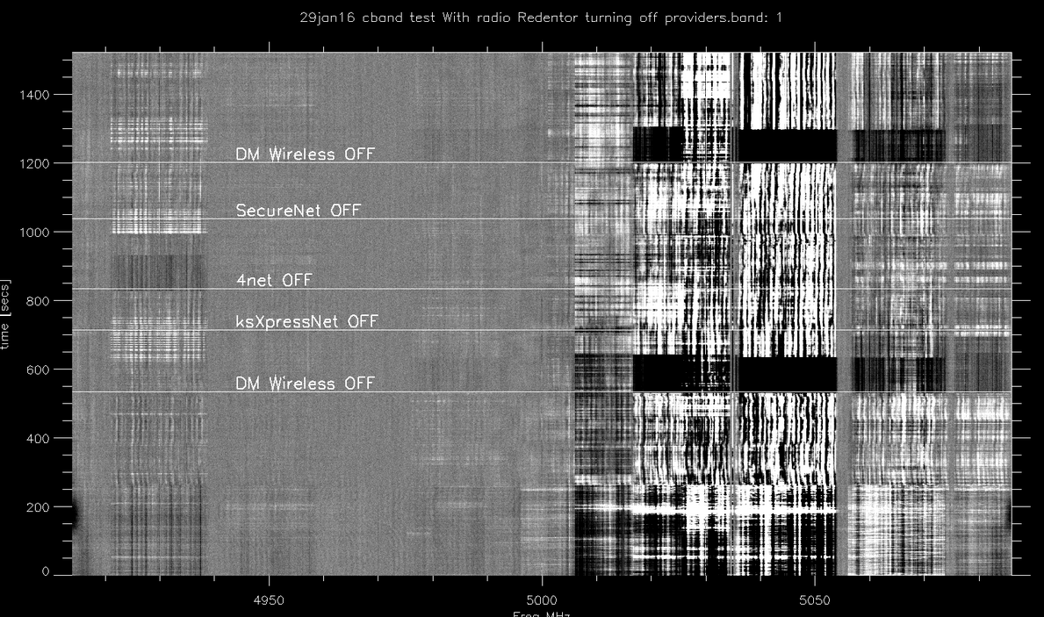
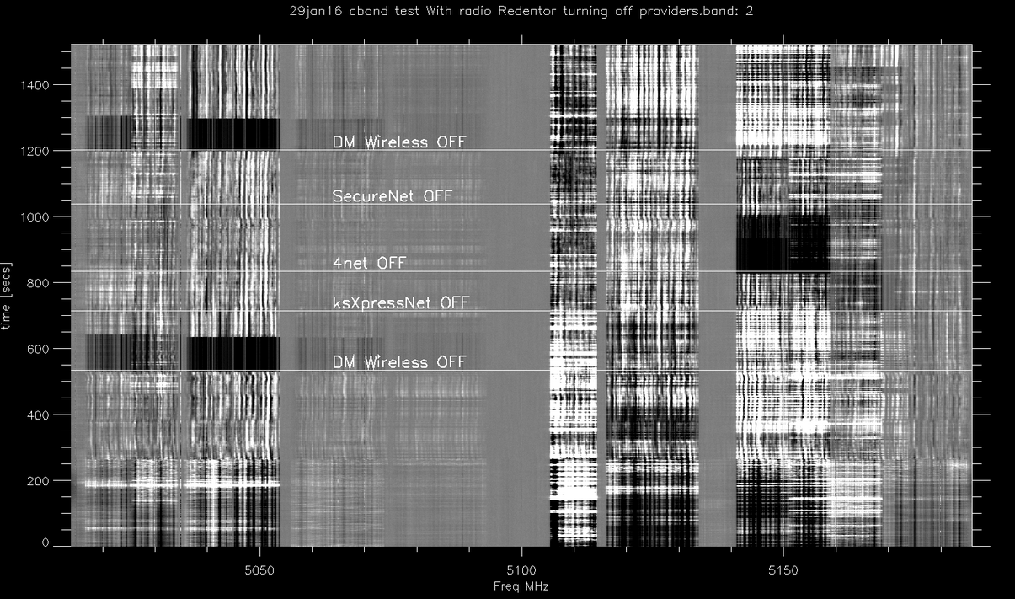
Cband interference
U-NII (Unlicensed National Information Infrastructure)
Used by internet providers (801.11a/h/j/n/ac)
Supposed to be above 5150 Mhz…
19Jan16 road trip found radio redentor tower in Utuado had out of band transmissions.
29jan16 tower operator cycled users on off while we took data:
Dynamic spectra during test showed who was illegal
4Net, and DM wireless were out of band
There was more than 1 user some freq bands (maybe from another tower).

Slide 16
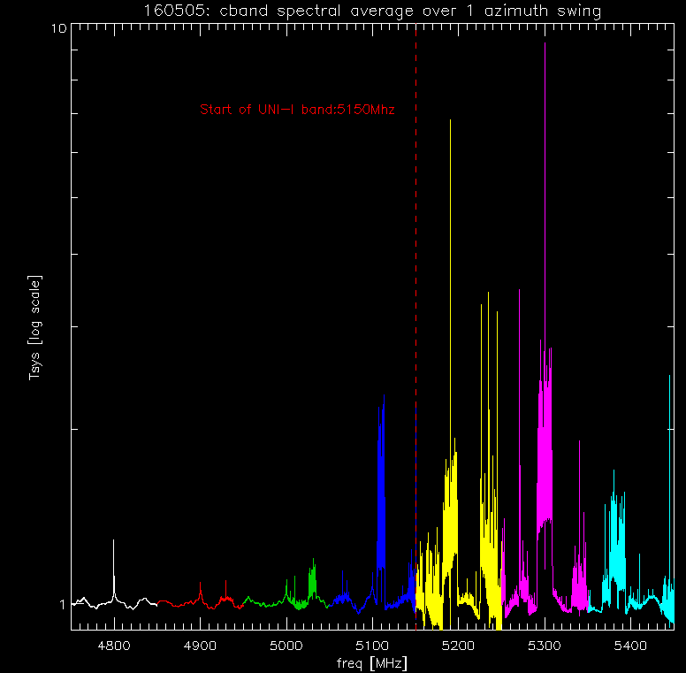
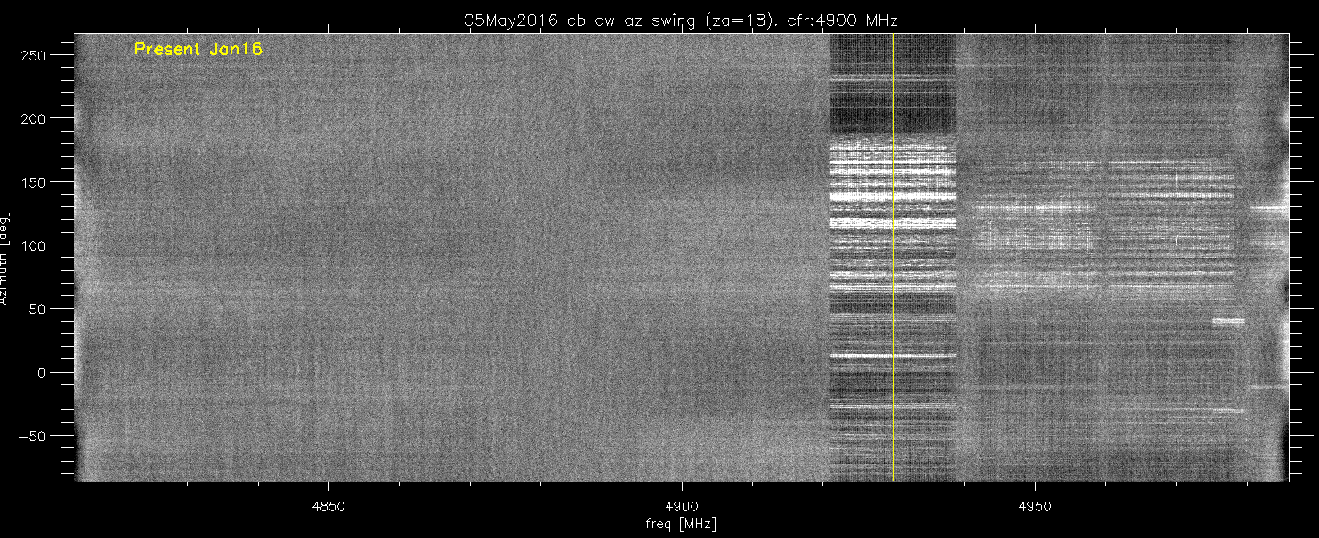
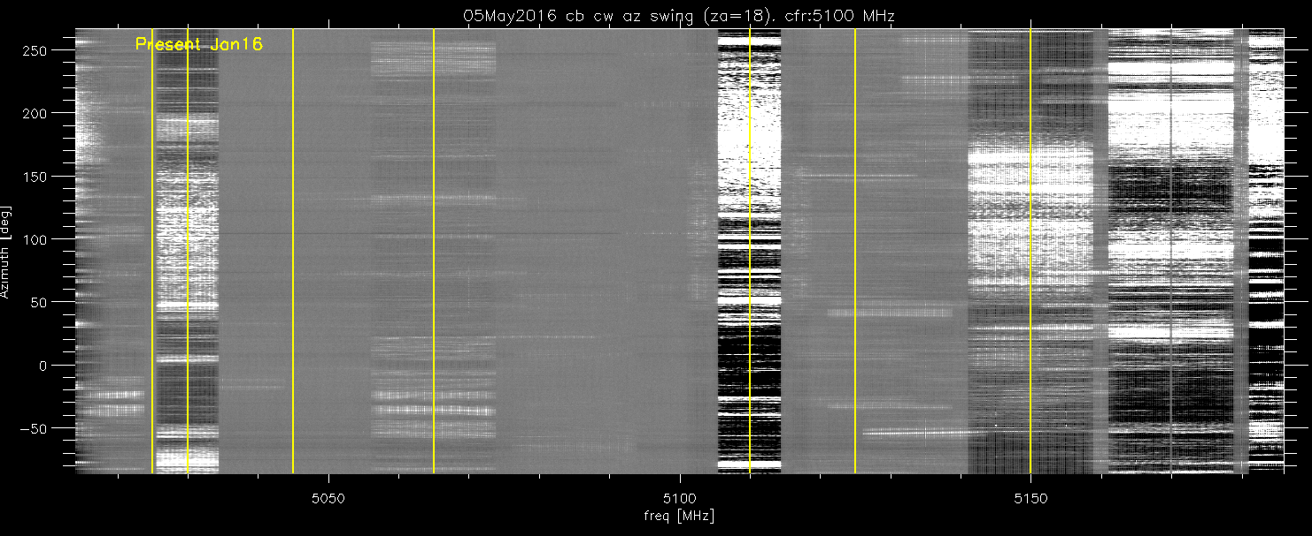
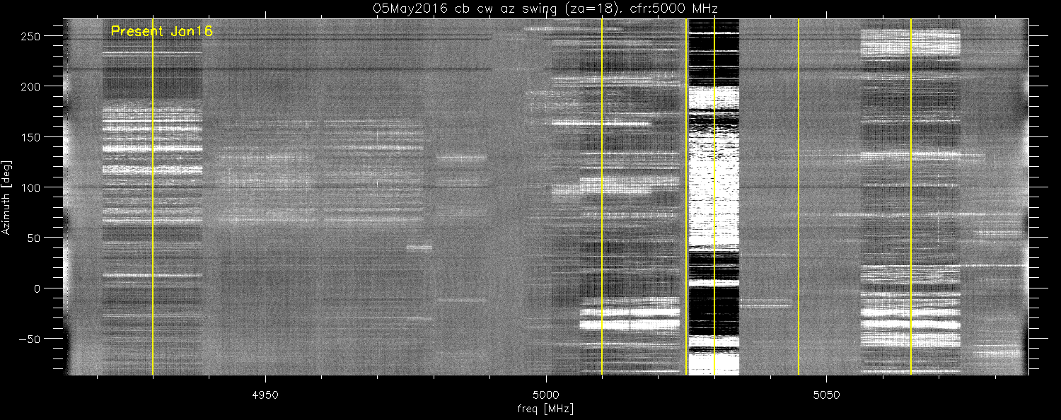
Cband interference
I checked some of the stronger signals.
Moving the LO left the signals at the same rf frequency, so probably not intermods in our system.
DM wireless moved it’s illegal freq up above 5150…but
05may16: another set of azimuth swings at cband:
Average spectra over entire 360 degrees still shows transmissions below 5150 MHz.
Dynamic spectra of the swing shows the offenders.
yellow lines show what was seen back in jan16.
Still have lots of work to clean up the offenders.

Slide 17
Miscellaneous
327 receiver:
2nd harmonic of FM stations are getting into the band
Also seeing intermods between the two fm xmter in utuado (radio redentor and HQ.. The towers are within 50 meters of each other).
We purchased a calibrated log periodic antenna that can cover 100 and 327 Mhz simultaneously. Need to go near the xmters to see if their 2nd harmonics are legal.
Lots of the other spikes in the 327 band are coming from our equipment..
Visitor center displays
Took data with spectrum analyzer, and some data from the 305 meter.. Need to finish reducing it..and then figure out how to shield the displays..

Slide 18
Summary
Lband radars continue to be a problem.
Coordination with punta Salinas becomes essential. When not in mode A,B,or C, the 100 channels completely wipe out lband..
Note (do we really need 4 radar sites in Puerto rico?)
Sband:
Notched filter at 2130 got rid of aws1 rfi.
Lost this portion of the band, but intermods no longer spreading out.
AT&T 2270 should not transmit out of their allowed band
Need to find the WIFI transmissions at 2380 mhz…
Need the 2390-2400 wifi transmissions to move up.
Cband
Spend more time looking for the source of the transmissions below 5150 MHz.

