Slide 1
Telescope status
2013 APRPP review committee
Phil Perillat

Slide 2
Talk Outline
Timeline of some events during 2013
Performance:
Gain,Tsys,SEFD, surface error.
Pointing error.
Issues.
RFI:
Misc:
Online: http://www.naic.edu/~phil/talks/talks.html →oct13_aprpp

Slide 3
Timeline of some events
Date | Event
01apr13 | Remy carsr radar up. (1269,1274),(1327,1332)
12jul13 | Dome drag link comes loose.
25jul13 | Testing ao19 on telescope
01aug13 | Sbn 1st stage amps fried by xmter (shutter bypassed)
05aug13 | 430 dome turnstile junction damaged. Replaced with old one.
08aug13 | Faa carsr radar up (1252,1257),(1344,1349)
17sep13 | 430 dome polA cavity filter repaired.

Slide 4
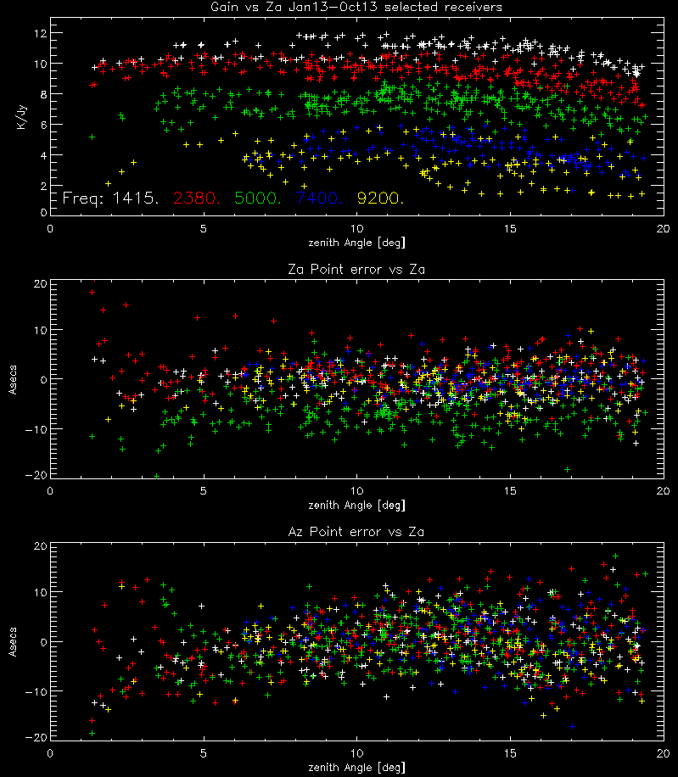
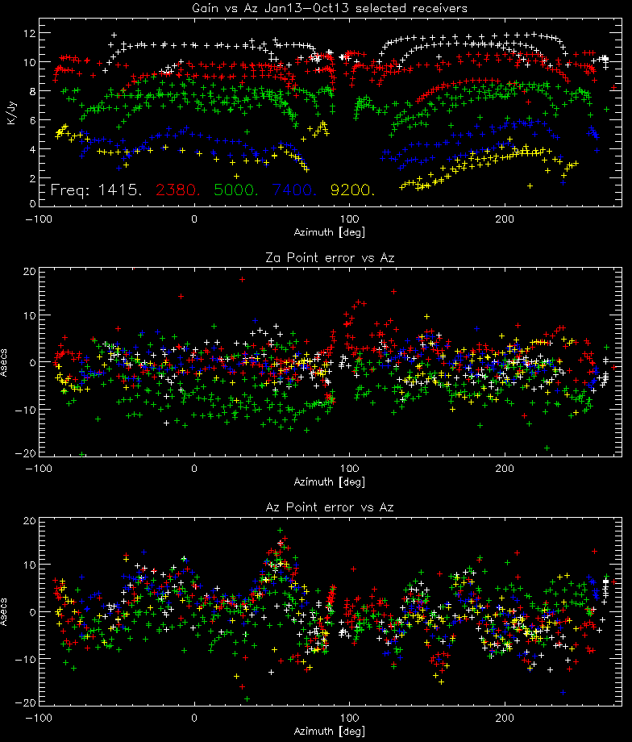
Gain and pointing error vs az,za
Data from calibration runs jan13 to oct13
Use selected frequencies: lbw,sbn,cb,cbhi,xband
Gain, pointing errors vs za.
Gain falloff za > 15 is spillover
Gain, pointing errors vs az
Az 140-170 shows gain drop off for high frequencies. Could be:
Td 4 losing tension
Platform tilt (but don’t see 180 deg symmetry).
Dish motion caused by southeast fill area.

Slide 5
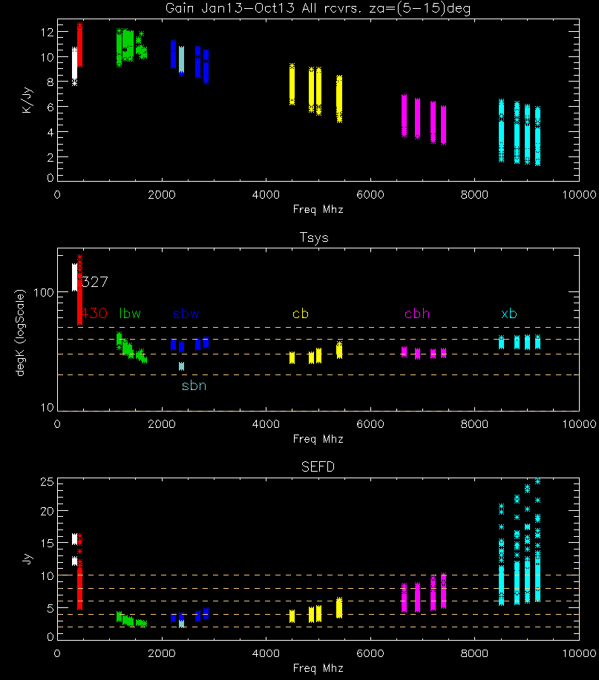
Gain,Tsys, SEFD vs freq
Limit za 5-15 deg (spillover,collimation)
Spread in value from az,za variation
Gain,Tsys depend on accurate cal values
SEFD (Tsys/Gain) only depends on srcFlux.
430 had tsys problems from cavity filter.
SEFD variation cbh,xb coming from gain, not Tsys.
Use gain vs freq to measure surface errror.

Slide 6
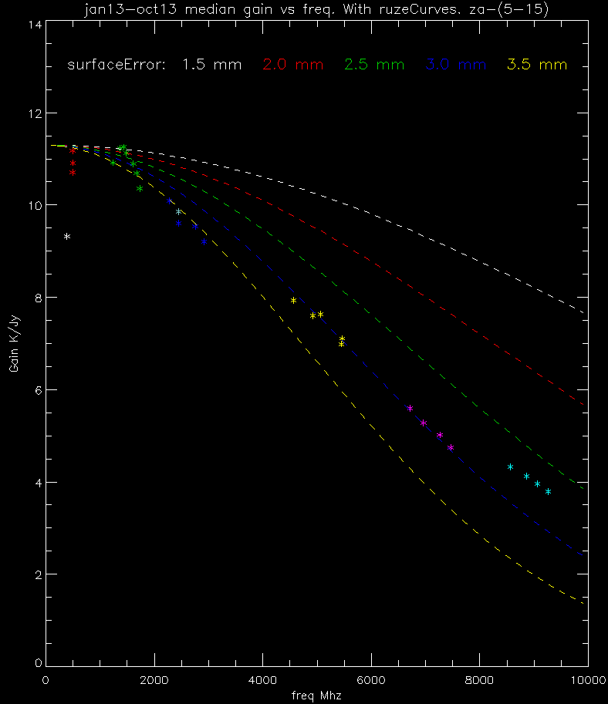
Gain vs Freq:ruze curves
Optical surface errors: Ruze formula:
$G=g0∗e^{−\left(\frac{4∗pi∗SurfErr}{lambda}\right)∗∗2}$
g0=gain at infinite wavelength (no errors).
Assumes uncorrelated errors. Collimation errors (pitch, roll, focus,..) will mix in with surface errors.
Non surface error gain variations:
collimation errors especially at high frequencies
(eg. Horn position, Platform tilt, elevation, az rail misalignment.)
Horn illumination of tertiary may differ (327).

Slide 7
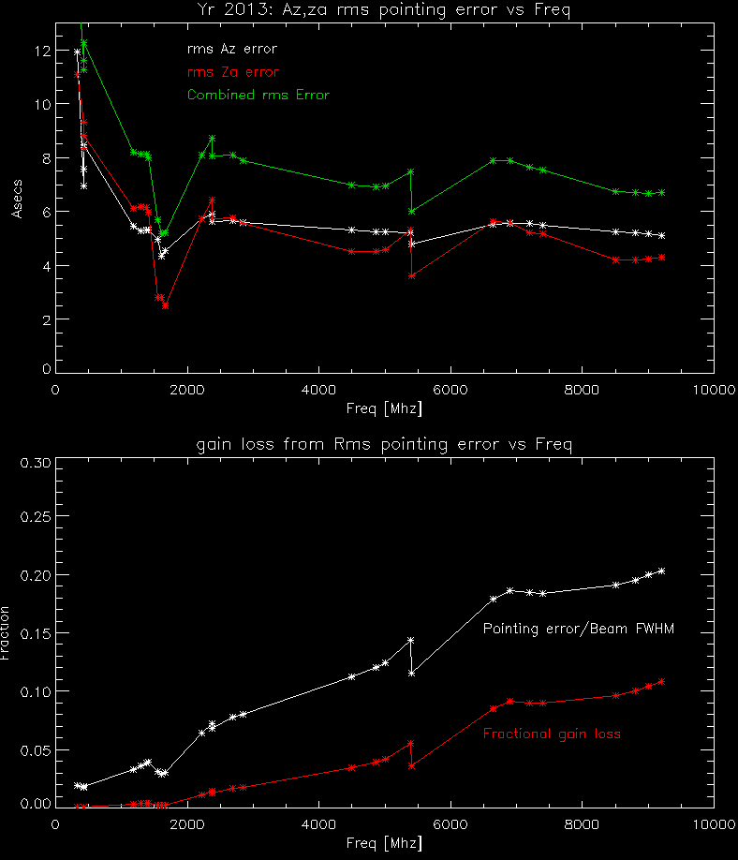
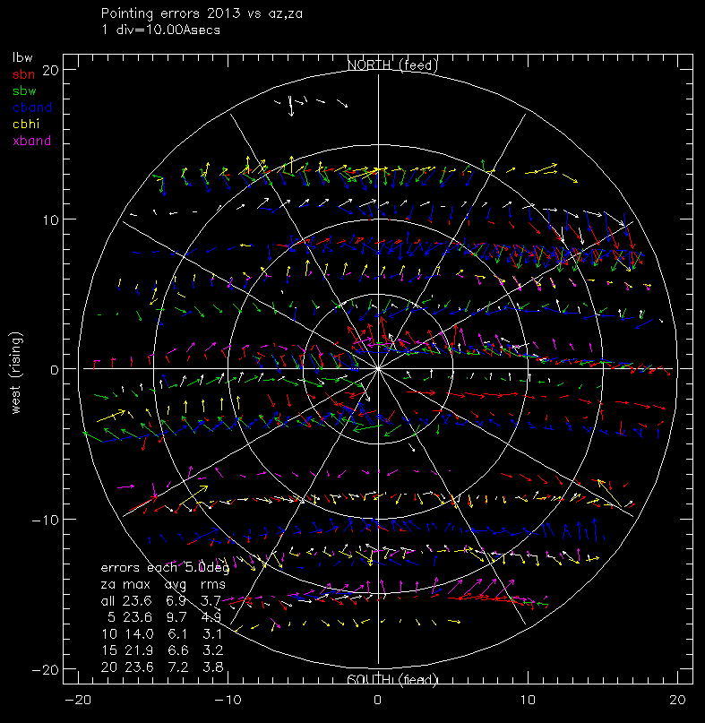
Pointing error
Arrow plot of pointing errors
Length of error is pnt error (1tick=10asecs)
Direction of arrow is error direction
Color is frequency/receiver
Rms pointing error by freq/receiver
Dips are freq with few measurements
Gain loss from pointing error assumes gaussian
Remember:Rms error is only 68% of the time

Slide 8
Issues: performance
Distomats need to be replaced.
Current distomats no longer available and they are starting to fail. Possible replacements make rfi.
We need to start surveying the optics again.
Horns, tertiary, secondary, dome position.
Would be great if we could continually monitor the position of the dome with an automated theodolite (could replace distomats)
We also need to learn to use or rewrite lynn bakers old programs to analyze the data.
Dome is still over weight.

Slide 9
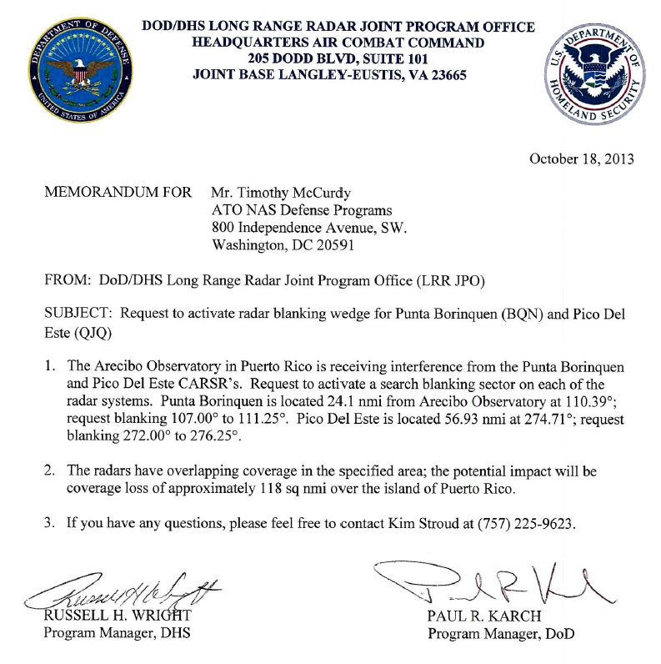
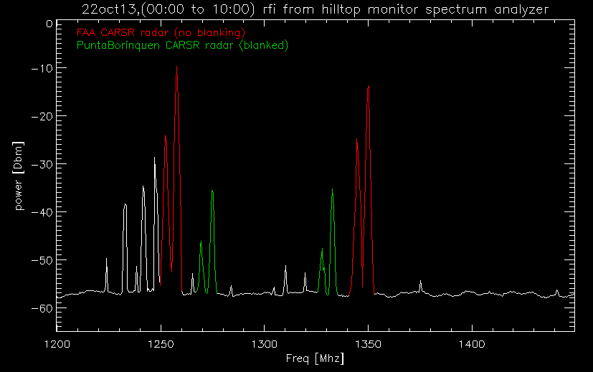
RFI: CARSR radars
CARSR (Common Air Route Surveillance Radar) are replacing the FAA and Punta Borinquen radars.
Rfi from hilltop monitor spectrum
22oct13 00:00 thru 10:00 shows:
Unblanked FAA Radar
Blanked punta borinquen radar
The FAA radar is probably weaker than the punta borinquen radar because it is shielded by some hills and it is twice the distance.
Faa radar should start blanking soon…
Radar | Freq | Bandwd | Duty cycle | Sector Blanking | Dist nmi
Old FAA | 1330,1350 | .2 Mhz | .5% | no | 57
CARSR FAA | 1252.4,1257.6 1344.4,1349.6 | 1 Mhz chirped | 9% | Yes (but not yet) +/-2 deg | 57
Old Punta Borinquen | 1270 or 1290 | .2 Mhz | .5% | no | 24
CARSR PuntaBor. | 1269.4,1274.6 1327.4,1332.6 | 1 Mhz Chirped | 9% | Yes (01oct13) +/- 2 deg | 24

Slide 10
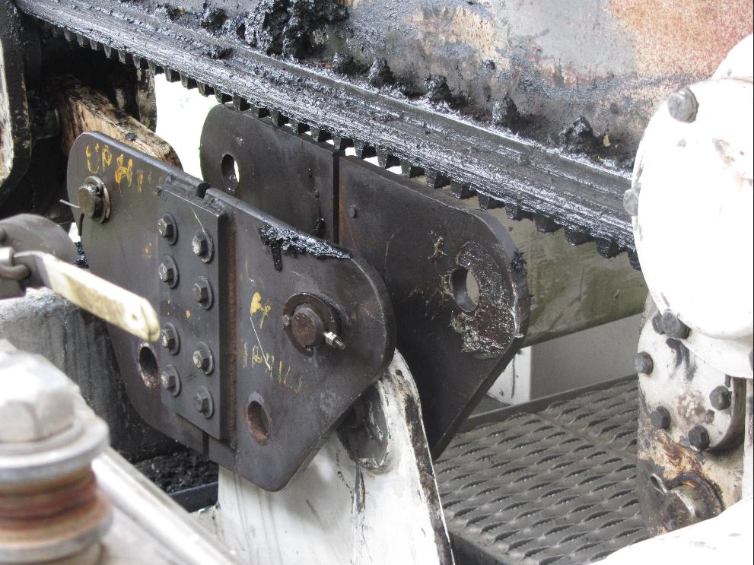
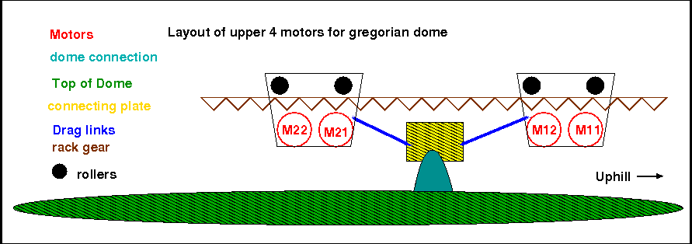
Dome drag link comes loose
On 12jul13 one of the 4 drag links on the dome came loose.
The drag links connect the motors to the dome
The drag links only pull,push the dome. They do not support the dome’s weight.
The small cotter pin probably snapped (from play in the drag link). Eventually the pin came loose on one side and bent the connection plate.
Fix:
New plates and drag links were constructed.
The cotter pin was replaced with something that won’t break.

Slide 11
Any questions?

