Slide 1
Telescope status & RFI
2014 AOUC committee
Phil Perillat

Slide 2
Talk Outline
Timeline of some events during 2014
Performance:
Gain,Tsys,SEFD, surface error.
Pointing error.
RFI:
Online: http://www.naic.edu/~phil/talks/talks.html →apr14 aouc

Slide 3
Timeline of some events
Date | Event
01apr13 | Remy carsr radar up. (1269,1274),(1327,1332)
12jul13 | Dome drag link comes loose.
25jul13 | Testing ao19 on telescope
05aug13 | 430 dome turnstile junction damaged. Replaced with old one.
08aug13 | Faa carsr radar up (1252,1257),(1344,1349)
13jan14 | 6.4 mag earthquake damages main cable m8-4
11mar14 | Telescope motion restored

Slide 4
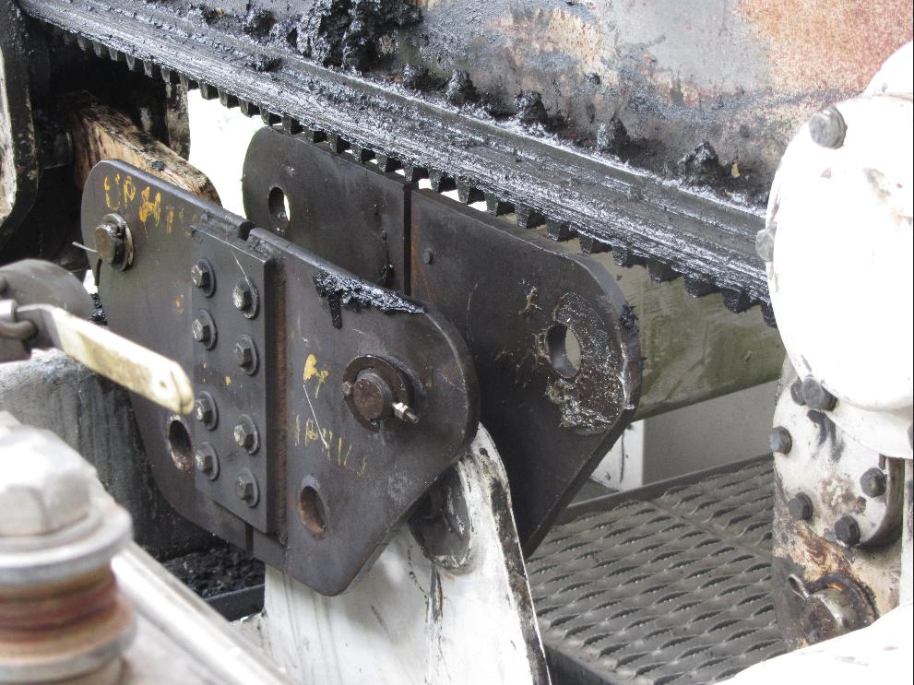
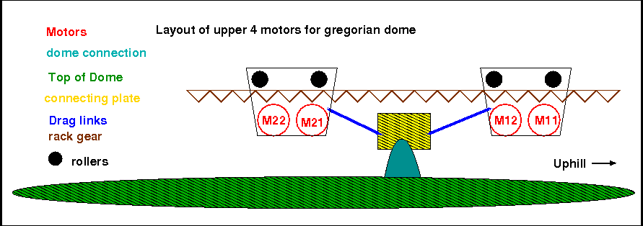
Dome drag link comes loose
On 12jul13 one of the 4 drag links on the dome came loose.
The drag links connect the motors to the dome
The drag links only pull,push the dome. They do not support the dome’s weight.
The small cotter pin probably snapped (from play in the drag link). Eventually the pin came loose on one side and bent the connection plate.
Fix:
New plates and drag links were constructed.
The cotter pin was replaced with something that won’t break.

Slide 5
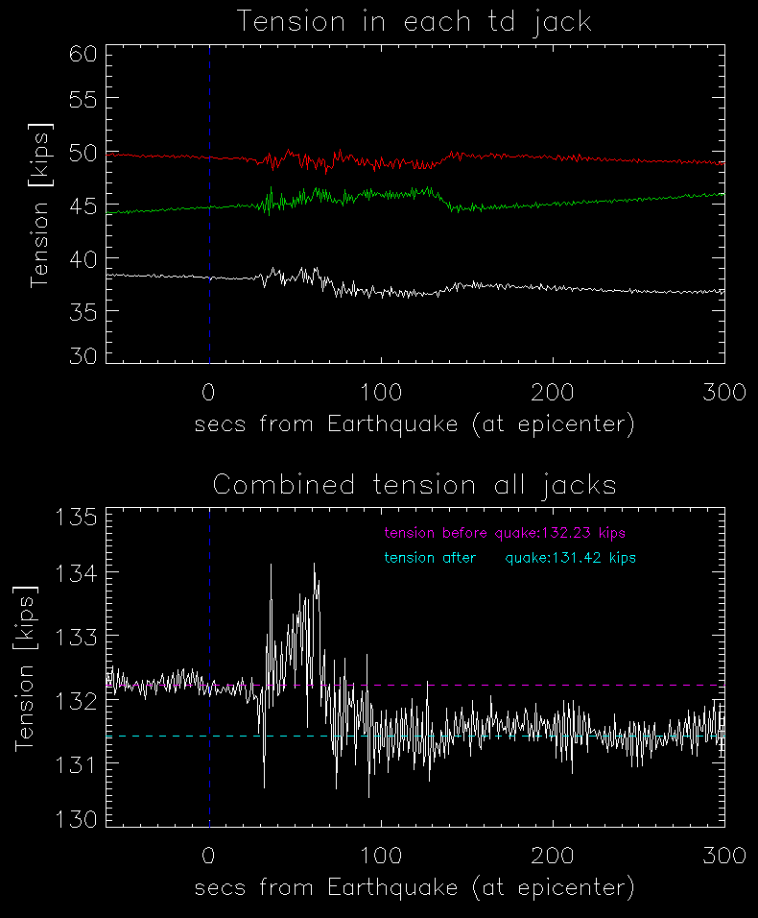
earthquake 13jan14
6.4 mag earthquake 13jan14
82Km NNw of AO, depth:36 km
Each tiedown has two loadcells that measure the tension where the td jack connects to the td cable.
Tiedown tension normally shows the oscillation of the platform caused by the earthquake.
This time the total tension measured by the load cells did not return to the value prior to earthquake.
Smaller tension → the distance from platform to td jack decreased

Slide 6
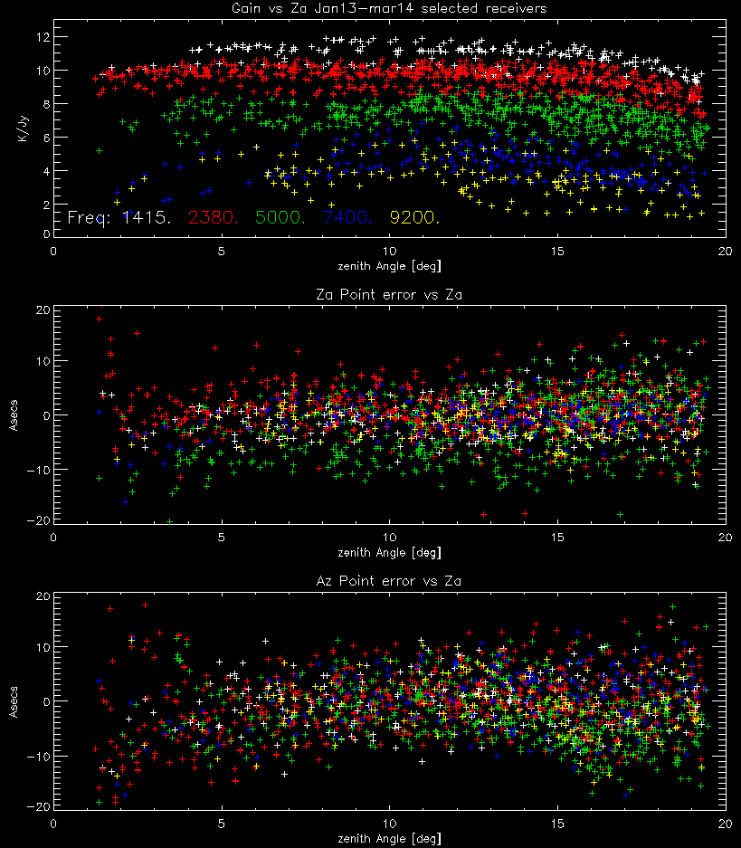
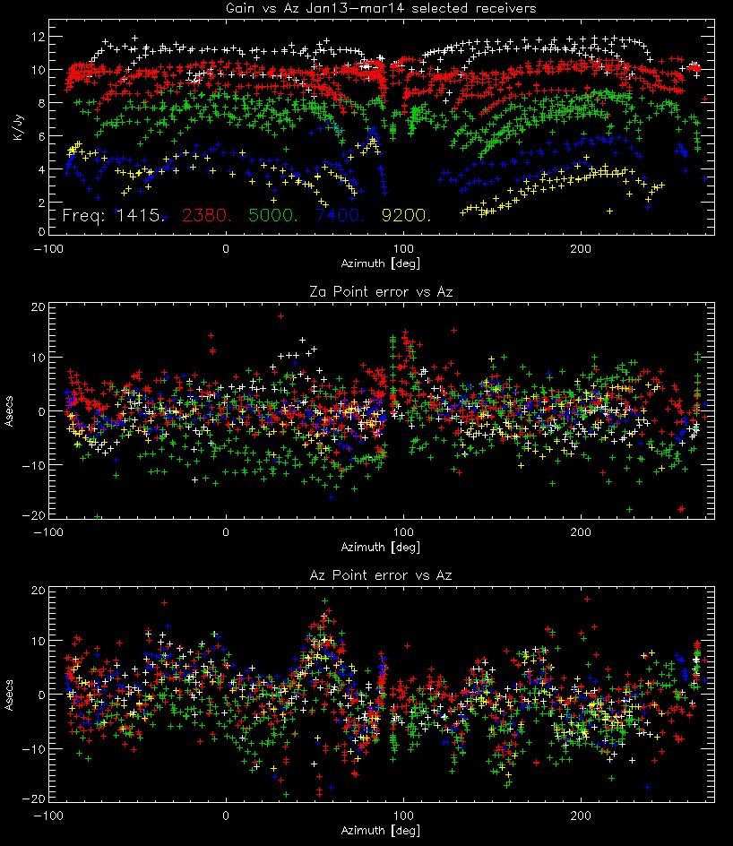
Gain and pointing error vs az,za
Data from calibration runs jan13 thru mar14
Use selected frequencies: lbw,sbn,cb,cbhi,xband
Gain, pointing errors vs za.
Gain falloff za > 15 is spillover
Gain, pointing errors vs az
Az 140-170 shows gain drop off for high frequencies. Could be:
Td 4 losing tension
Platform tilt (but don’t see 180 deg symmetry).
Dish motion caused by southeast fill area.

Slide 7
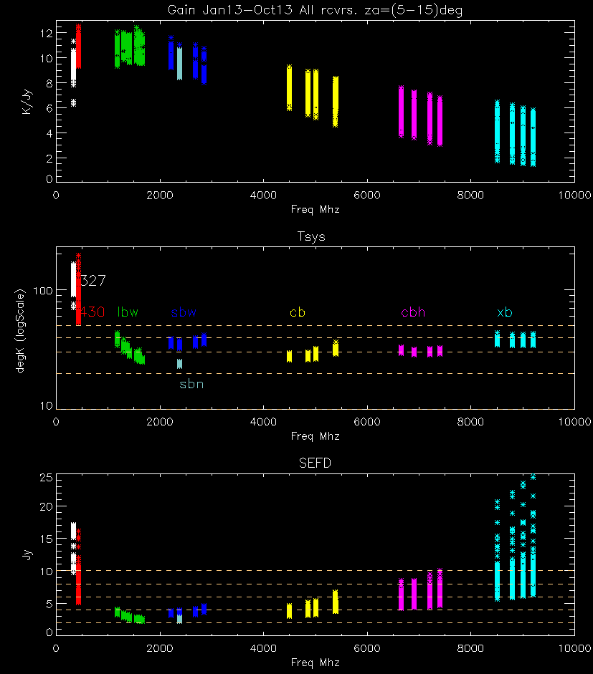
Gain,Tsys, SEFD vs freq
Limit za 5-15 deg (spillover,collimation)
Spread in value from az,za variation
Gain,Tsys depend on accurate cal values
SEFD (Tsys/Gain) only depends on srcFlux.
430 had tsys problems from cavity filter.
SEFD variation cbh,xb coming from gain, not Tsys.
Use gain vs freq to measure surface errror.

Slide 8
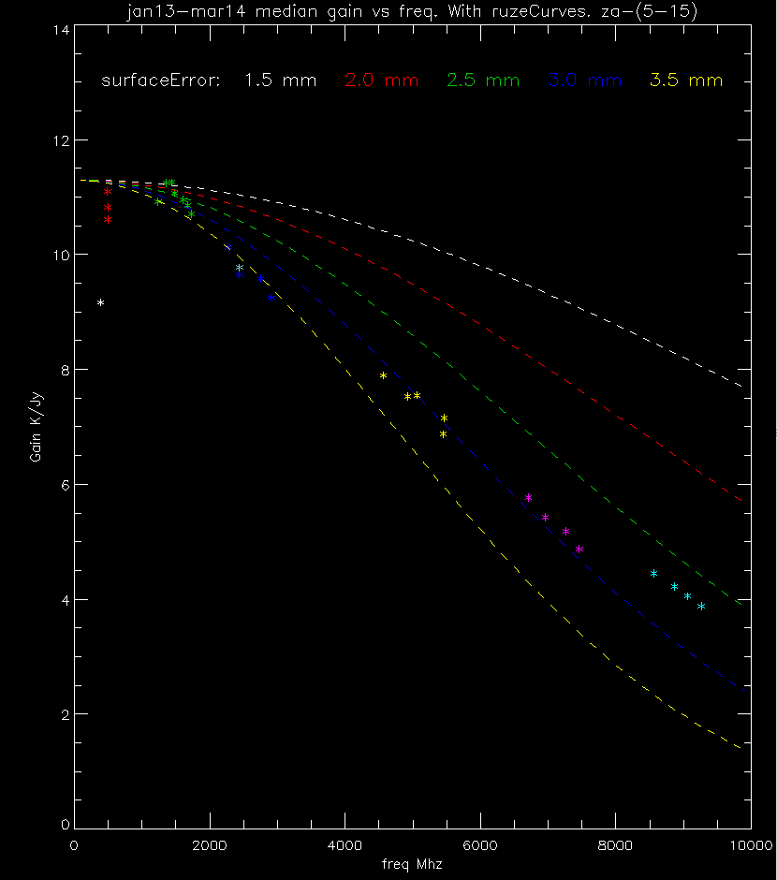
Gain vs Freq:ruze curves
Optical surface errors: Ruze formula:
$G=g0∗e^{−\left(\frac{4∗pi∗SurfErr}{lambda}\right)∗∗2}$
g0=gain at infinite wavelength (no errors).
Assumes uncorrelated errors. Collimation errors (pitch, roll, focus,..) will mix in with surface errors.
Non surface error gain variations:
collimation errors especially at high frequencies
(eg. Horn position, Platform tilt, elevation, az rail misalignment.)
Horn illumination of tertiary may differ (327).

Slide 9
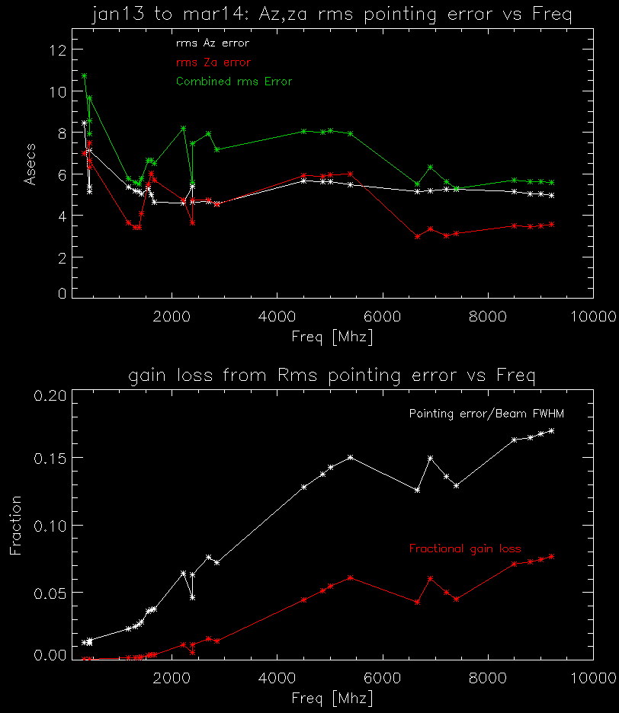
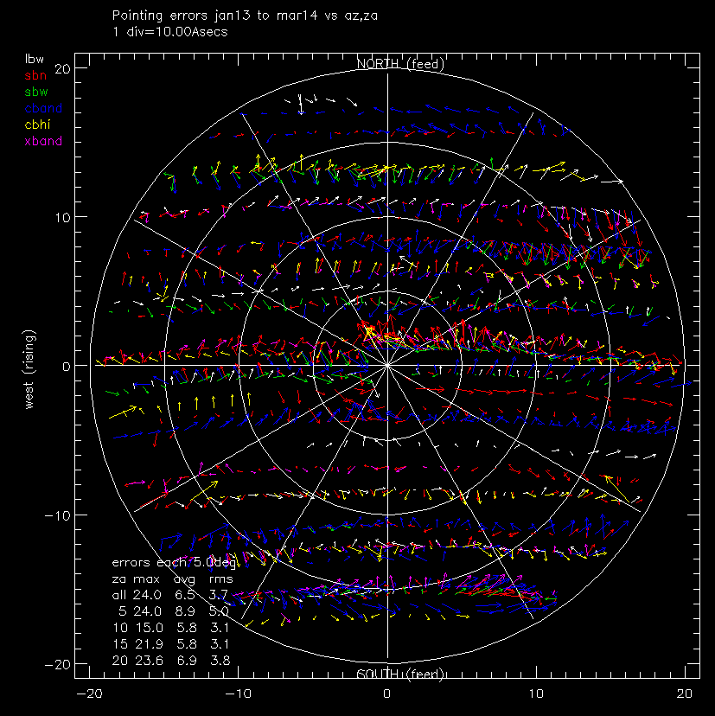
Pointing error
Arrow plot of pointing errors
Length of error is pnt error (1tick=10asecs)
Direction of arrow is error direction
Color is frequency/receiver
Rms pointing error by freq/receiver
Gain loss from pointing error assumes gaussian
Remember:Rms error is only 68% of the time

Slide 10
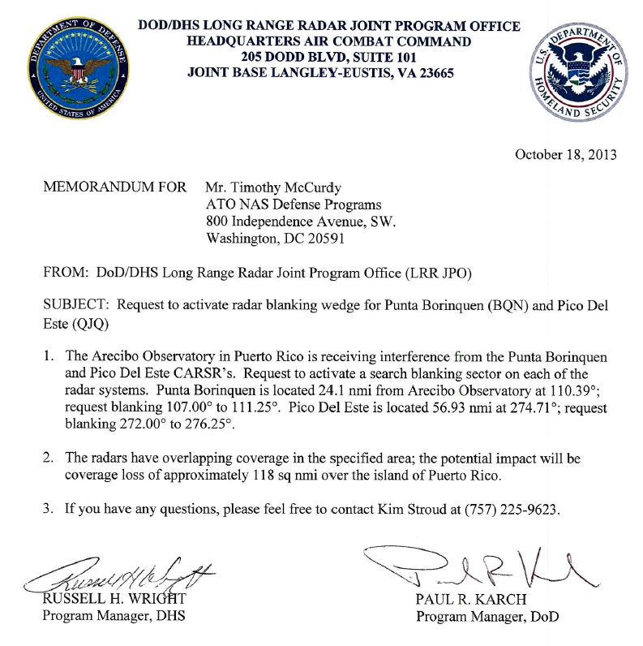
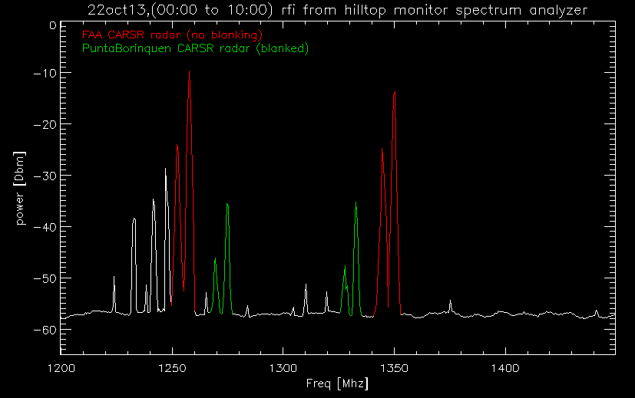
RFI: radars
CARSR (Common Air Route Surveillance Radar) are replacing the FAA and Punta Borinquen radars.
Rfi from hilltop monitor spectrum
22oct13 00:00 thru 10:00 shows:
Unblanked FAA Radar (started blanking 01nov13)
Blanked punta borinquen radar
Beam width probably 1.4 deg.
Blanking is +/- 2 deg.
Aerostat radar coming back online
Old freq: (1261,1246), (1256,1241)
Radar | Freq | Bandwd | Duty cycle | Sector Blanking | Dist nmi
Old FAA | 1330,1350 | .2 Mhz | .5% | no | 57
CARSR FAA | 1252.4,1257.6 1344.4,1349.6 | 1 Mhz chirped | 9% | Yes (01nov14) +/-2 deg | 57
Old Punta Borinquen | 1270 or 1290 | .2 Mhz | .5% | no | 24
CARSR PuntaBor. | 1269.4,1274.6 1327.4,1332.6 | 1 Mhz Chirped | 9% | Yes (01oct13) +/- 2 deg | 24

Slide 11
Any questions?

